Slide 1

DASIL Python Workshop # 2
April 14
Introduction to Machine Learning
Yusen He, PhD - DASIL Data Scientist
Martin Pollack – DASIL Mentor

Slide 2
Intro to Machine Learning
Agenda
Machine Learning Basics
Supervised Learning – Algorithms
Supervised Learning – Regression Evaluation
Supervised Learning – Classification Evaluation
Unsupervised Learning – Algorithms and Evaluation

Slide 3
What is Machine Learning?
A type of Artificial Intelligence that learns from data
Computer algorithms that improve without being explicitly programmed
Training Data
Learning Algorithm
Build Model
Prediction
Feedback

Slide 4
What is Machine Learning?
Supervised Learning
Unsupervised Learning
Dimension Reduction
Regression
Classification
Clustering
Reinforcement Learning (not covered)

Slide 5
Supervised vs. Unsupervised Learning
Supervised learning
Groundtruth label is provided
Algorithm learns how to predict labels of new observations
Unsupervised learning
No groundtruth label provided
Self-guided learning
Algorithm learns structures/patterns in the data
Notes:
1-5 Martin

Slide 6
Supervised Learning
Regression: predict continuous outcome
Linear regression
Non-linear regression
Outcome
Predictor
Outcome
Predictor

Slide 7
Supervised Learning
Classification: predict discrete outcome/predict group data belongs to
Binary classification
Multi-categorical classification
Predictor 2
Predictor 2
Predictor 1
Predictor 1

Slide 8
Classification or Regression?
In Class Question:
Suppose we want to predict the probability that a person will get approved for a credit card.
We have data from Visa on everyone who submitted a credit card application in 2021.
Is this a classification or regression problem?
Notes:
6-8 Yusen

Slide 9
Unsupervised Learning
Clustering: assign data to groups which themselves don't have a meaning
Predictor 2
Predictor 2
Predictor 1
Predictor 1

Slide 10
Unsupervised Learning
Dimension reduction: put high-dimensional data into lower dimensions for ease of interpretation/visualization
Case # | A1 | A2 | ... | A200
1 | 3.3 | 16.65 | ... | 1
2 | 2.4 | 14.32 | ... | 0
... | ... | ... | ... | ...
100,000 | 5.8 | 22.68 | ... | 0
Case # | X1 | X2
1 | 0.56 | 1.37
2 | 0.94 | 0.86
... | ... | ...
100,000 | 0.02 | 1.14
Notes:
9-10 Martin

Slide 11
Supervised Learning - Algorithms
Supervised Learning
Regression
Classification
Linear Regression
k-nearest neighbors
Decision Tree
Random Forest
Boosting Trees
Support Vector Machine
Neural Network
Logistic Regression
Naïve Bayes

Slide 12
Supervised Learning - Linear Regression
Find the line that best describes the data
Minimize the sum of squared residuals
Data must have a linear trend (or can add quadratic/cubic terms)
Relies on statistical assumptions for proper analysis

Slide 13

Supervised Learning – Logistic Regression
Similar to linear regression, but…
Binary classification
A generalized linear model
Fitting “S” shape with a logit link:
Choose threshold to determine class label (Usually=0.5)
Outcome
1
Logit function
0
Predictor

Slide 14
Supervised Learning - Naïve Bayes
A probabilistic classifier
Assume independence assumptions between features (variables)
Applies Bayes’ theorem:
$$P\left(c | X\right)=P\left(x_{1} | c\right)×P\left(x_{2} | c\right)×…×P\left(x_{n} | c\right)×P(c)$$
Posterior probability
Likelihood
Class prior probability
Notes:
11-14 Yusen

Slide 15
Parameters vs. Hyperparameters
Parameters are estimated from data
e.g. Intercept/slope in linear regression
Hyperparameters determine what kind of model to fit
Chosen before you fit the model with data
Do not depend on the data

Slide 16
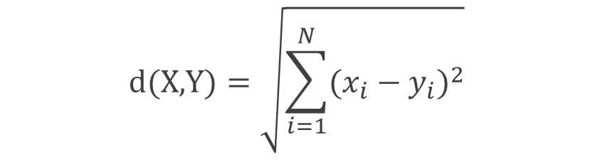
Supervised Learning – K-Nearest Neighbor
Predicted label is average of/most common label among the k nearest neighbors
NNs ordered by Euclidean distance:
Simple and easy to implement!
Hyperparameters:
k
distance metric
$$\text{d}\text{(}\text{X}\text{,}\text{Y}\text{)}=\sqrt{\sum_{i=1}^{N}{{(x_{i}−y_{i})}^{2}}}$$
?
Predictor 2
Predictor 1

Slide 17
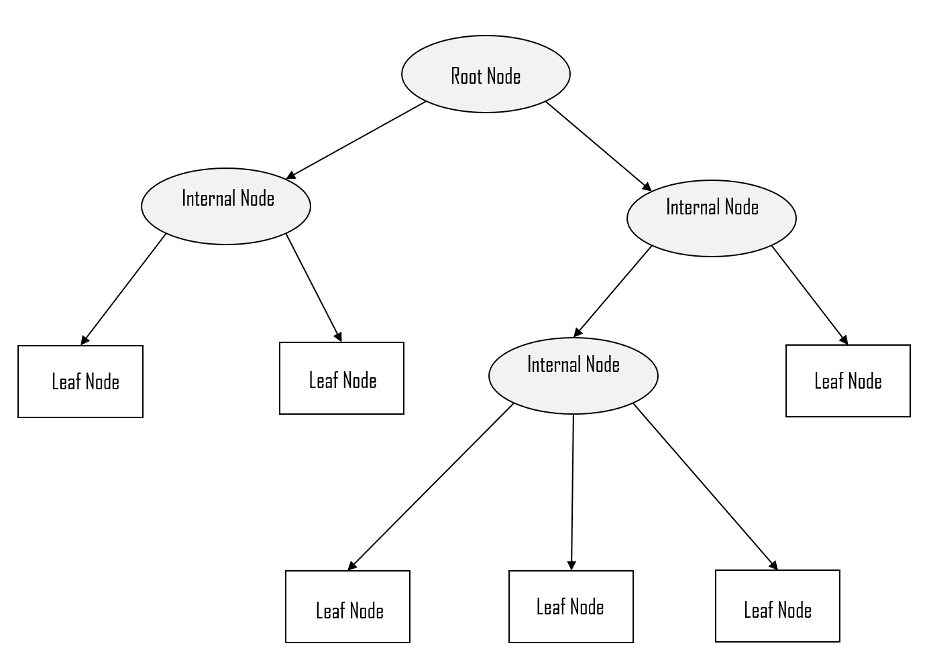
Supervised Learning – Decision Tree
Non-linear model for classification & regression
Split data into smaller groups to minimize entropy and impurity
Prone to overfitting
Hyperparameters:
Maximum tree depth
Minimum decrease in entropy/impurity needed for a split
Number of features to consider at each split

Slide 18

Supervised Learning – Random Forest
Combine multiple trees
Bootstrap aggregating or "bagging":
Each tree trained on a bootstrap sample of training set
Results of each tree are combined for final prediction
Hyperparameters:
Tree hyperparameters
Number of trees
Dataset
…
Tree # 1
Tree # 2
Tree # N-1
Tree # N
$$∑$$

Slide 19
Supervised Learning – XGBoost
Multiple trees, but hierarchically stacked
“Boosting” approach:
New trees are trained based on the errors of the previous trees
Results again averaged across trees
Hyperparameters:
Tree hyperparameters
Learning rate
Dataset
Errors
Tree # 1
Errors
Tree # 2
Tree # 3

Slide 20
Pop Quiz!
Talk to your neighbor about the difference between bagging and boosting.
Notes:
15-20 Martin

Slide 21
Supervised Learning – Support Vector Machine
Predict new data labels by creating a hyperplane (one dimension lower than data) to split objects on
Usually performs well in classification tasks
Form of the border between classes is specified with “Kernel”
Hyperparameters:
Kernel (e.g., linear vs polynomial)
C (how bad is it to misclassify a point?)
Support vectors (class-1)
Support vectors (class-2)
Margin

Slide 22

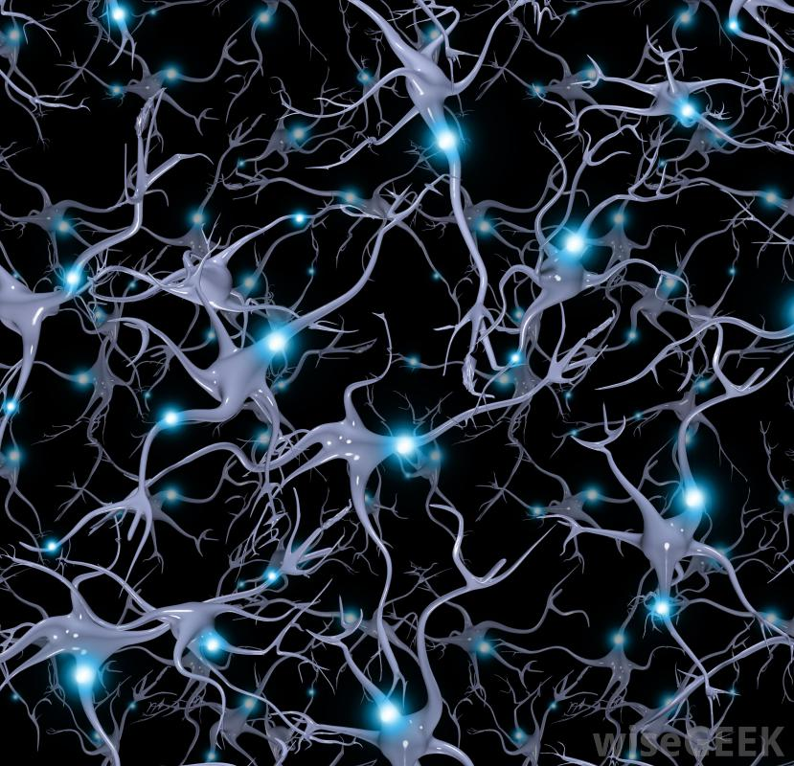
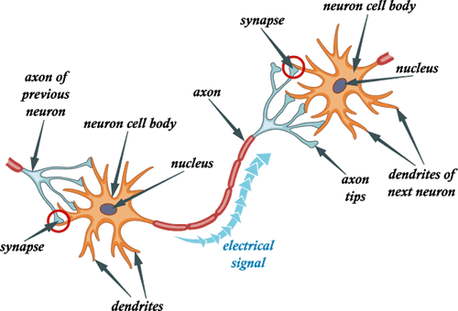
Supervised Learning – Artificial Neural Network
Most popular Machine Learning algorithm!

Slide 23












Supervised Learning – Artificial Neural Network
Three components:
Input layer
Hidden layer
Output layer
a
…
…
…
Output layer
Input layer
Hidden layer

Slide 24









Supervised Learning – Artificial Neural Network
Parameters:
Weights
Bias
Hyperparameters:
Number/size of hidden layers
Activation function
Weight starting values
Learning rate
$$x_{1}$$
$$w_{1}$$
$$\hat{o}=σ(\sum{w_{i}x_{i}+b})$$
$$x_{2}$$
$$w_{2}$$
bias: b
σ()
$$y$$
……
$$w_{n}$$
Weighted sum
Activation function
Output value
$$x_{n}$$
Input layer
Hidden layer

Slide 25

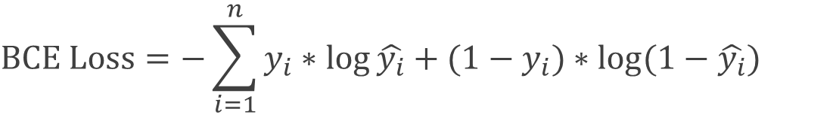
Supervised Learning – Artificial Neural Network Loss Functions
Regression loss:
Mean square error loss
Classification loss:
Binary cross entropy loss
$$MSE=\frac{1}{n}\sum_{i=1}^{n}{{\left(y_{i}−\hat{y_{i}}\right)}^{2}}$$
$$BCE Loss=−\sum_{i=1}^{n}{y_{i}∗\log{\hat{y_{i}}}}+{(1−y}_{i})∗\log{(1−\hat{y_{i}})}$$

Slide 26
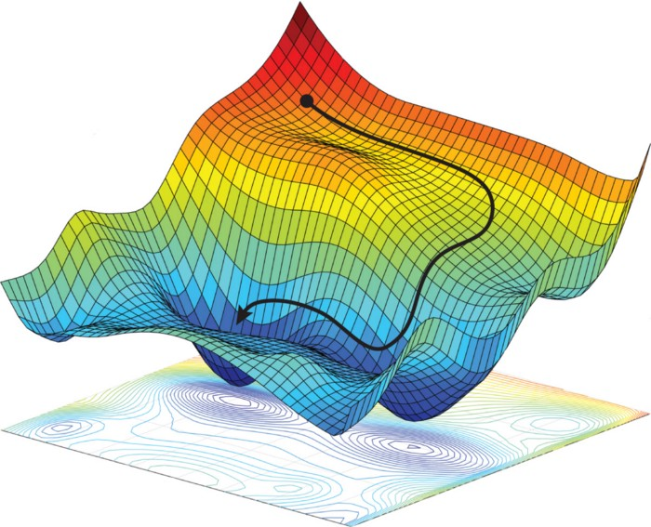
Supervised Learning – How to Fit an Artificial Neural Network
An optimization problem
Minimize the loss using gradient
Backpropagation

Slide 27




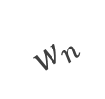








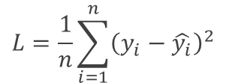
Supervised Learning – How to Fit an Artificial Neural Network
Learning Approach: backpropagation
$$x_{1}$$
$$w_{1}$$
$${w_{1}}^{∗}$$
σ()
$$\hat{o_{i}}=σ(\sum{w_{i}x_{i}+b})$$
$$x_{2}$$
$$w_{2}$$
$$b$$
$$b^{∗}$$
$${w_{2}}^{∗}$$
$$y$$
….
$$L=\frac{1}{n}\sum_{i=1}^{n}{{\left(y_{i}−\hat{y_{i}}\right)}^{2}}$$
$${w_{n}}^{∗}$$
……
Weighted sum
Activation function
Output signal
Compute loss
$$w_{n}$$
$$x_{n}$$
Input layer
Notes:
21-27 Yusen

Slide 28

Model Selection
a
…
…
…

Slide 29
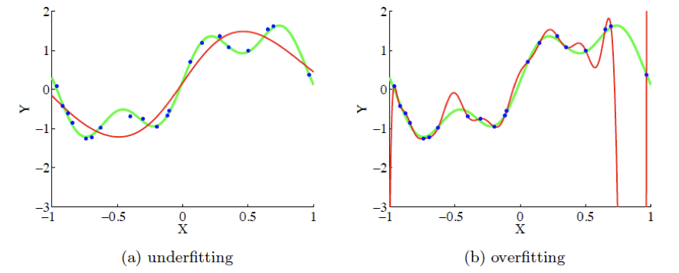
Overfitting versus Underfitting (or Bias-variance trade-off)

Slide 30
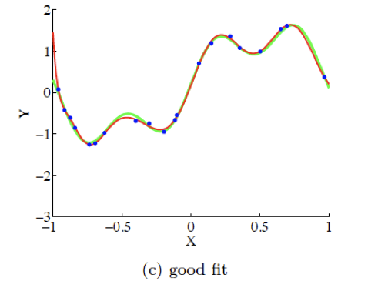
Overfitting versus Underfitting
Our model needs to be a good fit for NEW data
“A good model predicts the future not the past”
Generalization capacity is important
Notes:
28-30 Martin

Slide 31
Training / Testing Dataset Split
Single train-test split
Single train-test split with validation dataset
Training data
Test data
Training data
Validation data
Test data

Slide 32
Training / Testing Dataset Split
Cross-validation
Split 1
Split 2
Split 3
…….
Test dataset
Split N
Finding parameters
Final evaluation

Slide 33

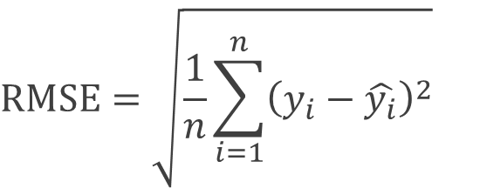

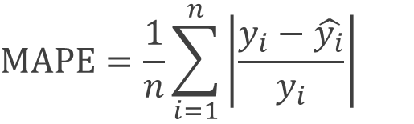
Measurement Metrices - Regression
$$MAE=\frac{1}{n}\sum_{i=1}^{n}{\left|y_{i}−\hat{y_{i}}\right|}$$
Mean Absolute Error (MAE):
Mean Absolute Percentage Error (MAPE):
Mean Square Error (MSE):
Root Mean Square Error (RMSE):
$$MAPE=\frac{1}{n}\sum_{i=1}^{n}{\left|\frac{y_{i}−\hat{y_{i}}}{y_{i}}\right|}$$
$$MSE=\frac{1}{n}\sum_{i=1}^{n}{{\left(y_{i}−\hat{y_{i}}\right)}^{2}}$$
$$RMSE=\sqrt{\frac{1}{n}\sum_{i=1}^{n}{{\left(y_{i}−\hat{y_{i}}\right)}^{2}}}$$

Slide 34
Measurement Metrices - Regression
In Class Question (Data scientist interview question):
Suppose you are predicting stock price for XYZ company for the next week and have made a prediction on the test dataset as follows:
Question: Which metric is going to be impacted most by the outlier Thursday?
A) Mean absolute error B) Mean absolute percentage error C) Mean square error D) Root mean square error
Weekdays | Mon | Tue | Wed | Thu | Fri
Actual | 68 | 72 | 76 | 110 | 74
Predicted | 69 | 70 | 77 | 60 | 70
Error | -1 | 2 | -1 | 50 | 4
Notes:
31-34 Yusen

Slide 35
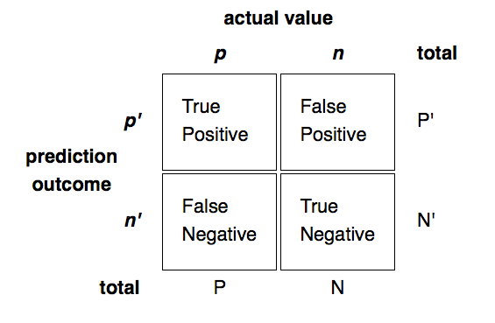
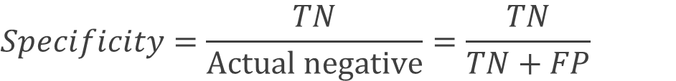
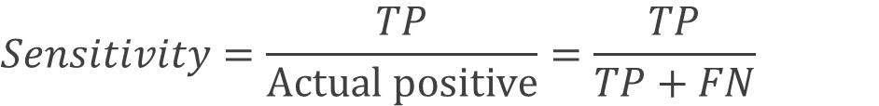
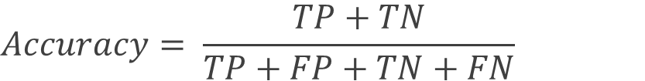
Measurement Metrices - Classification
Confusion Matrix:
$$Accuracy= \frac{TP+TN}{TP+FP+TN+FN}$$
$$Sensitivity=\frac{TP}{Actual positive}=\frac{TP}{TP+FN}$$
$$Specificity=\frac{TN}{Actual negative}=\frac{TN}{TN+FP}$$
Discuss:
If I am designing a COVID-19 test, is having a higher sensitivity or specificity more important?

Slide 36
Measurement Metrices - Classification
Area Under the ROC Curve
Measures how well the model can separate the groups
ROC Curve shows sensitivity/specificity for each decision boundary between 0 and 1
Higher AUC = better model
Model B
Model A
Baseline
(Random Guess)
Sensitivity
1 - Specificity
Notes:
35-36 Martin

Slide 37
Algorithms - Unsupervised Learning
Unsupervised Learning
Dimension Reduction
Clustering
K-means
DBSCAN
Principal Components Analysis

Slide 38

Unsupervised Learning - Clustering
Step #1: Random Mean Initialization
K-Mean Clustering
Lloyd’s algorithm
Cluster center 1
$$×$$
$$×$$
Cluster center 2

Slide 39

Unsupervised Learning - Clustering
Step #2: Assign class labels by distances
K-Mean Clustering:
Lloyd’s algorithm
Cluster center 1
$$×$$
$$×$$
Cluster center 2

Slide 40


Unsupervised Learning - Clustering
Step #3: Calculate cluster centers
K-Mean Clustering
Lloyd’s algorithm
$$×$$
Cluster center 1
$$×$$
Cluster center 2
$$×$$
$$×$$

Slide 41
Unsupervised Learning - Clustering
Step #4: Re-assign labels by distance
K-Mean Clustering
Lloyd’s algorithm
$$×$$
Cluster center 1
$$×$$
Cluster center 2
$$×$$
$$×$$

Slide 42
Unsupervised Learning - Clustering
Step #5: Re-calculate cluster centers
K-Mean Clustering
Lloyd’s algorithm
$$×$$
Cluster center 1
$$×$$
$$×$$
Cluster center 2
$$×$$
$$×$$
$$×$$

Slide 43
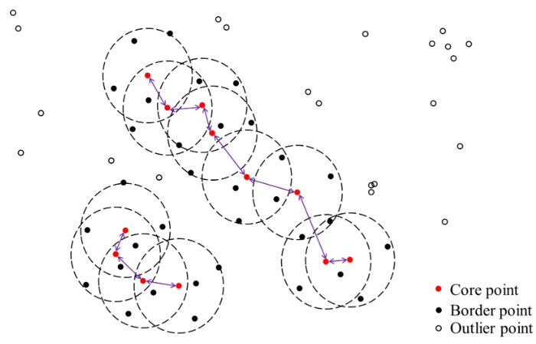
Unsupervised Learning - Clustering
Density-based spatial clustering of applications with noise (DBSCAN)
Notes:
37-43 Yusen

Slide 44
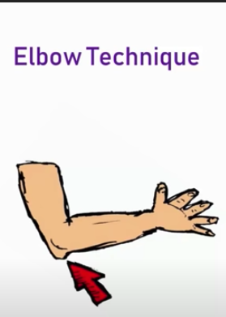
Unsupervised Learning – Clustering Evaluation
How to measure the clustering quality?
Elbow Technique
$$×$$
Cluster center
Inner Cluster Distances
Cluster center
$$×$$
Num of Clusters

Slide 45

Unsupervised Learning – Clustering Evaluation
How to measure the clustering quality?
Silhouette Coefficient:
a: The mean distance between a sample and all other points in the same cluster
b: The mean distance between a sample and all other points in the next nearest cluster
Sample

Slide 46
Unsupervised Learning – Clustering Evaluation
How to measure the clustering quality?
Silhouette Coefficient:
Optimal k
Silhouette Coefficient
a: The mean distance between a sample and all other points in the same cluster
b: The mean distance between a sample and all other points in the next nearest cluster
Num of Clusters
Notes:
44-46 Martin

Slide 47
Unsupervised Learning – Dimension Reduction
How to reduce dimensionality?
Principal Component Analysis (PCA) most popular method
Think about a high dimensional dataset
Which direction has the most variance?

Slide 48
Unsupervised Learning – Dimension Reduction
How to reduce dimensionality?
PC #1
PC#1 = 0.05X1-0.84X2+…+0.11X200

Slide 49
Unsupervised Learning – Dimension Reduction
How to reduce dimensionality?
PC #1
PC#1 = 0.05X1-0.84X2+…+0.11X200
PC#2 = 0.86X1+0.05X2+…-0.47X200
PC #2

Slide 50
Unsupervised Learning – Dimension Reduction
How to reduce dimensionality?
PC #1
PC#1 = 0.05X1-0.84X2+…+0.11X200
PC#2 = 0.36X1+0.05X2+…-0.47X200
PC #3
PC#3 = …..
PC #2

Slide 51
Unsupervised Learning – Dimension Reduction
Principal components are:
Orthogonal (or "perpendicular") to one another
Linear combinations of predictor variables
# of Principal components = # of variables
Keep principal components that explain most of the variation -> reduce dimensionality
PC #1
PC #3
PC #2

Slide 52
Unsupervised Learning – Dimension Reduction
In Class Question (Data scientist interview question):
Suppose you have an original lung cancer patient dataset which contains 16 variables (e.g., X1, X2, …, X16). Now, using PCA, you select the top two principal components as your new variable set:
PC1 = 0.32X1+0.58X2+…+0.64X16
PC2 = 0.05X1+0.94X2+…+0.31X16
Question: Is PCA a linear or non-linear approach for dimension reduction?
Notes:
47-52 Yusen

